Slide 1
Wastewater Treatment
ENEL 380: Automation and Control
Project Presentation (Spring/Summer 2019)
Instructor: Dr. Keegan Downie
Daniel Takyi
Naz Faiz
Ufuoma Aya
Lab Design Project: Automation and Control of Wastewater Treatment Process

Slide 2
Introduction
Wastewater (sewage water) is water that has been utilized for domestic, commercial or industrial processes.
Can be treated for re-use by a wastewater treatment plant.
Large scale wastewater treatment processes require automation and control.

Slide 3
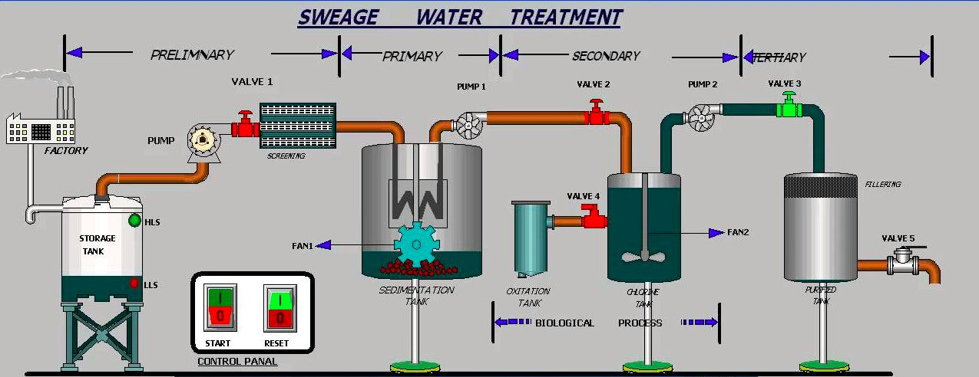

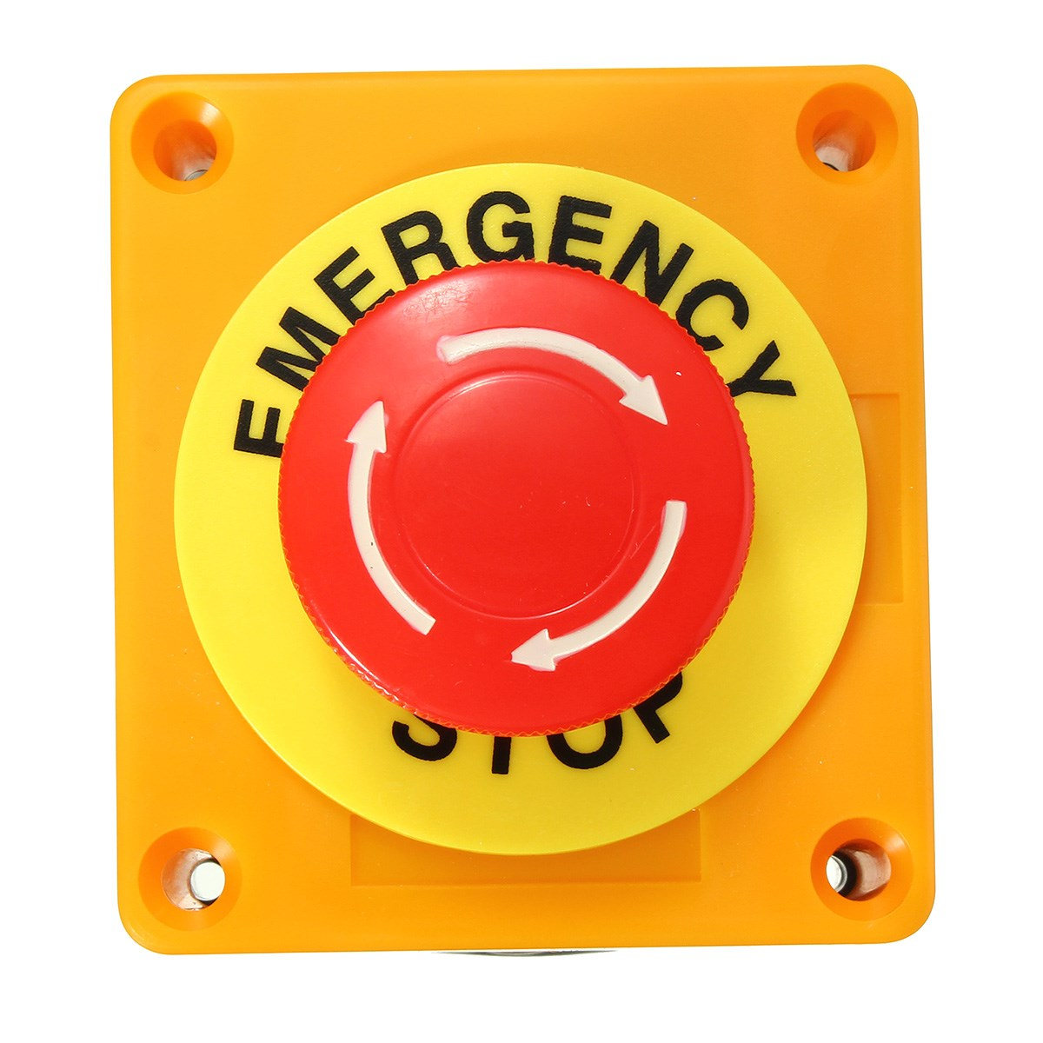
Overview of the system

Slide 4
Purpose of Wastewater Treatment
Enables the water to be re-used
Reduce ecological footprint
Consistent water supply
Proactive approach to meet future needs

Slide 5
Purpose of the system
Make the process easy to control
Automate the process to a desired degree
Make the process more efficient
Enables control over water supply

Slide 6
Overview of System Components
Pumps: Motors
Valves: Solenoids
Fan: Motors
Switches
Push Buttons

Slide 7
Operability Requirements
Energy Requirements
Flood Protection
Reliability and Redundancy
Plant Capacity Rating
Health and Safety
Odour Control
Sludge and Scum Handling and Disposal
Plant Operators Safety Training

Slide 8
Process/System Requirements
Preliminary Treatment: Screening and grit handling and disposal
Primary Treatment: Sludge and scum removal and disposal
Secondary Treatment: Biological waste handling and disposal
Tertiary Treatment: Chemical handling, storage and disposal
Other: Sampling and monitoring equipment and maintenance

Slide 9
Constraints
Effluent Quality Control
Airborne contaminant emissions
Odour limits, measurement and control
Noise control
Energy Conservation

Slide 10
Other Considerations
Geological Factors
Climactic Factors
Permafrost
Corrosion
Odour Control
Sludge and Scum Disposal

Slide 11
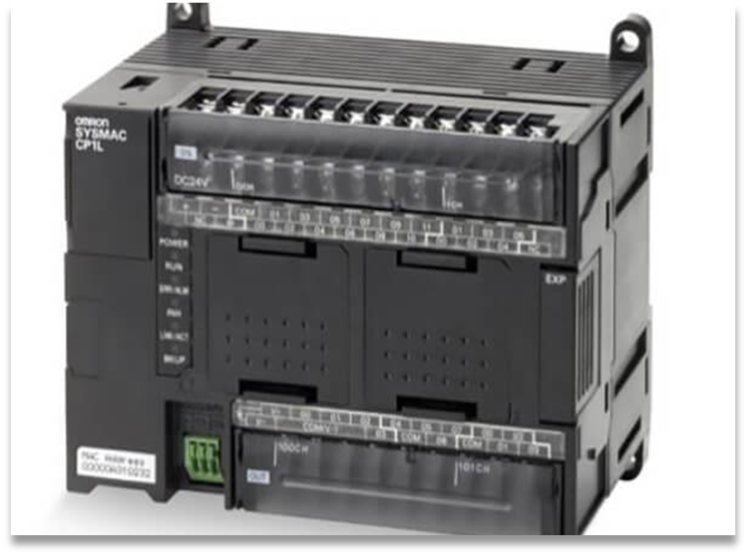
CP1l-M30DT-A PLC
Omron Electronics CP1 Series
Programmable Logic Controller CPU Module
Built-in USB port, 30 points:
18-DC inputs/12-NPN (transistor sinking) outputs
150 I/O max capacity, 120-240/AC
Safety:
Take fail-safe measures
Maintain specified range of voltage

Slide 12
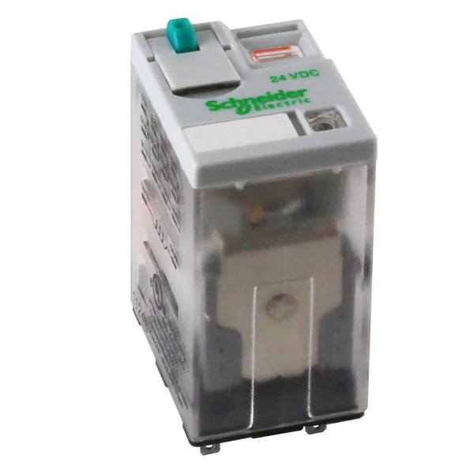
System Component Selection
Relays for Motors: 782XDX2M4L-24D
Manufacturer: Schneider Electric
Contact Form: 4PDT
Coil Voltage: 24 VDC
Contact Current Rating: 10 A
1/3 hp = 120 VAC
Safety:
Stay within voltage range and contact ratings

Slide 13
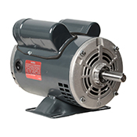
System Component Selection
Motor: C158A
Brand: Marathon
Voltage Type: AC
Horsepower Rating: 1/3 hp
Voltage Rating: 115/230 VAC, suitable for 208 VAC at 60 Hz
Rotation: Electrically Reversible
Safety:
Stay within the power rating of the motor.

Slide 14
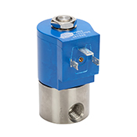
System Component Selection
2-way Solenoid for Valves: NS301YF02C3BE7
GC Valves water solenoid valve
2-port (2-way), 2-position, N.C.
Direct acting
303 stainless steel body
120/110 VAC, 10W, NSF/ANSI 61.

Slide 15
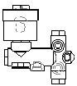
System Component Selection
3-way Solenoids for Valves: 8300D009U 120/60
ASCO Series 300 3-way solenoid valve
3 way - 3/2 Universal
Direct acting
Brass body
120 VAC

Slide 16
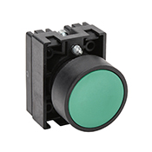
System Component Selection
Switches: ECP3102
NITRA 22mm pneumatic pushbutton
IP65
Plastic base, plastic bezel, black, operator only,
Operator: green, flush, 30mm, round, plastic.

Slide 17
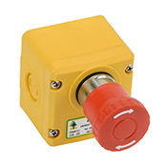
System Component Selection
Brand: IDEM ES-P-230001
Item: Emergency stop control station
Housing Material: Plastic
Operator type: 40mm mushroom
Operator Color and Action: Red, twist-to-release
Contact Type: (1) N.O./(2) N.C

Slide 18
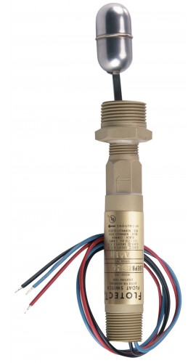
System Component Selection
Level Switches: Dwyer L6EPB-B-S-3-A
Service: Liquids compatible with wetted materials
Switch Type: SPDT snap switch
Electrical Rating: 5 A at 125/250 VAC (V~)
Weatherproof and explosion-proof body for demanding outdoor applications
Simple and dependable operation with no mechanical linkage

Slide 19
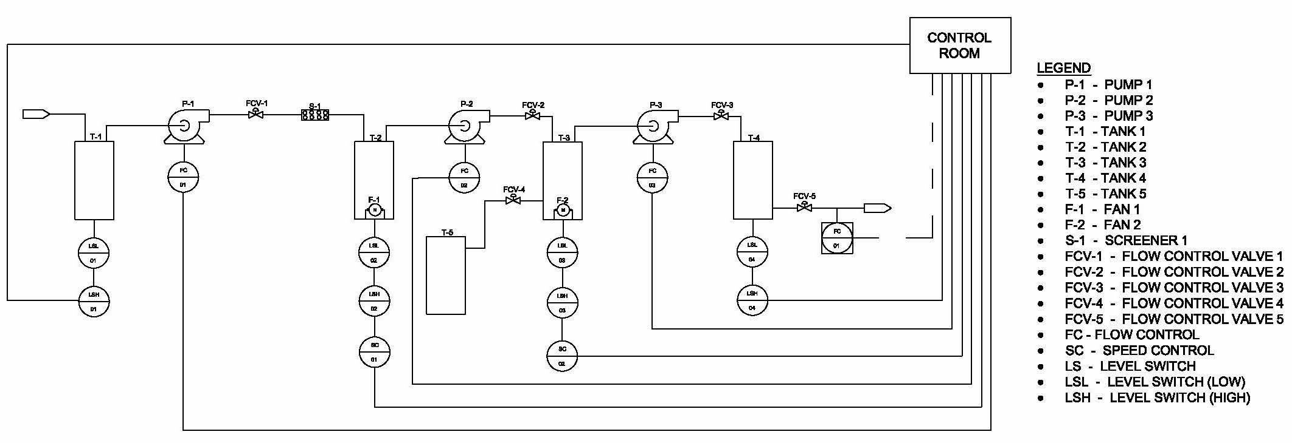
P&ID Model

Slide 20
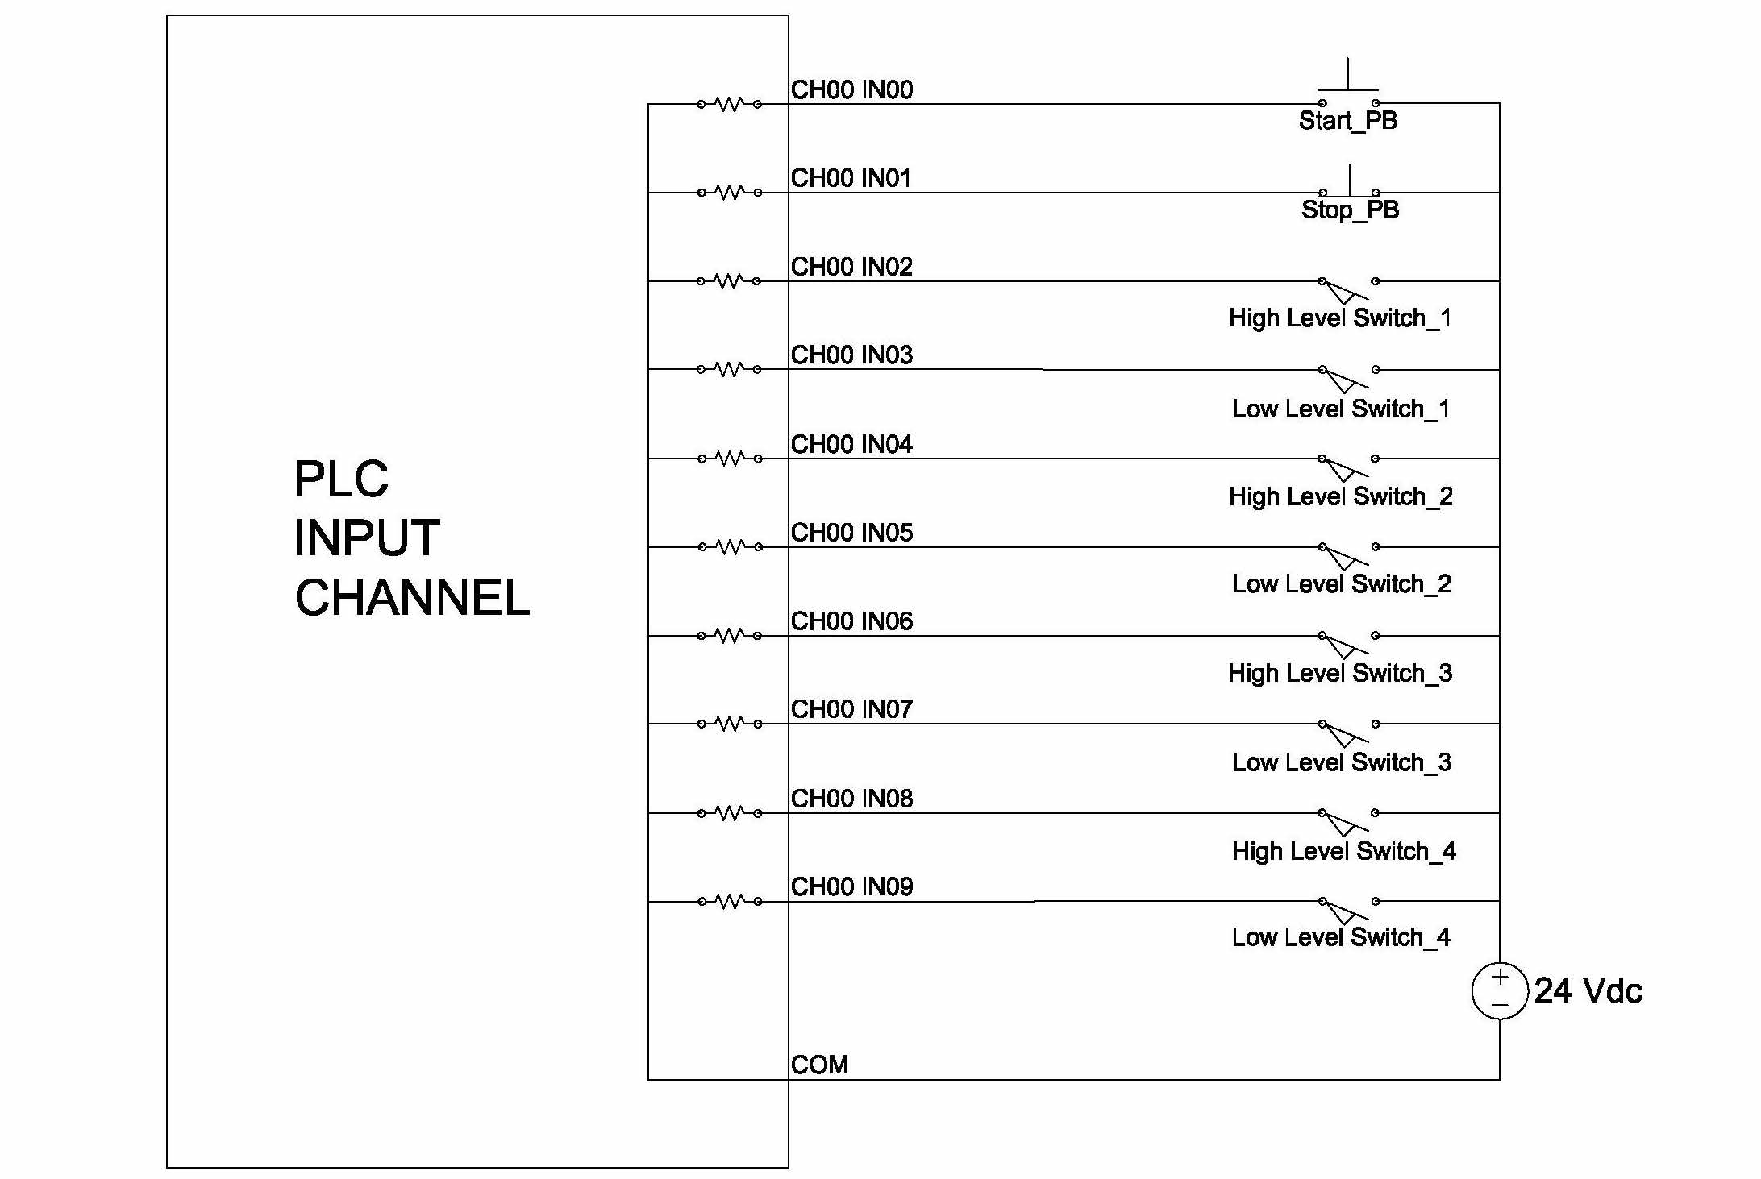
PLC Wiring Model (Input)

Slide 21
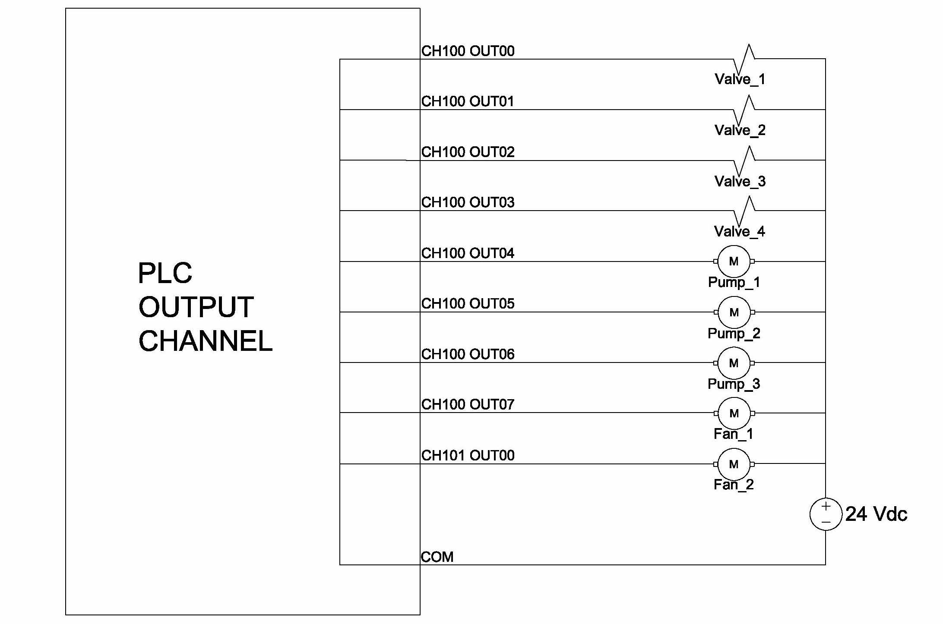
PLC Wiring Model (Output)

Slide 22
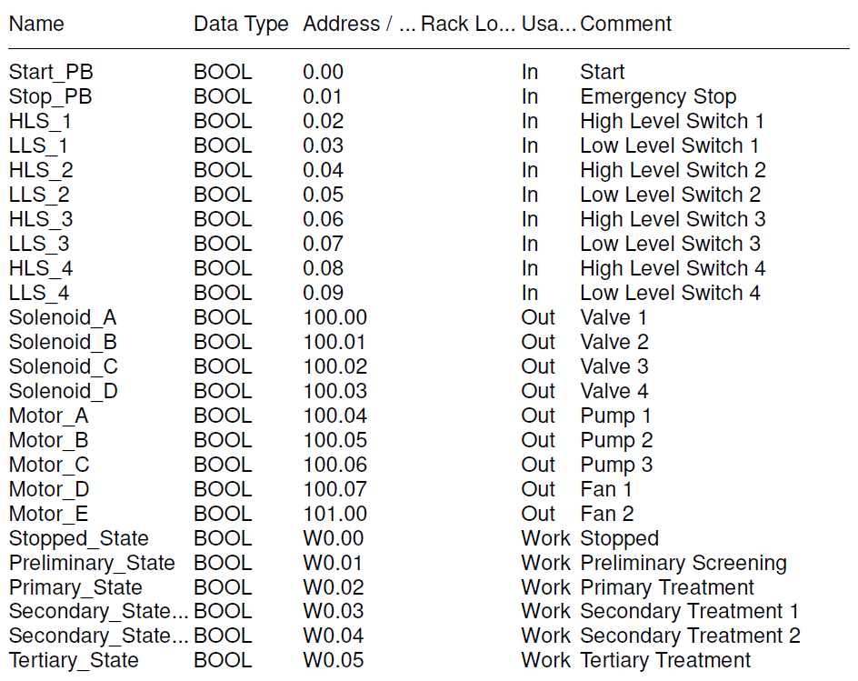
Sewage Treatment PLC Symbols

Slide 23
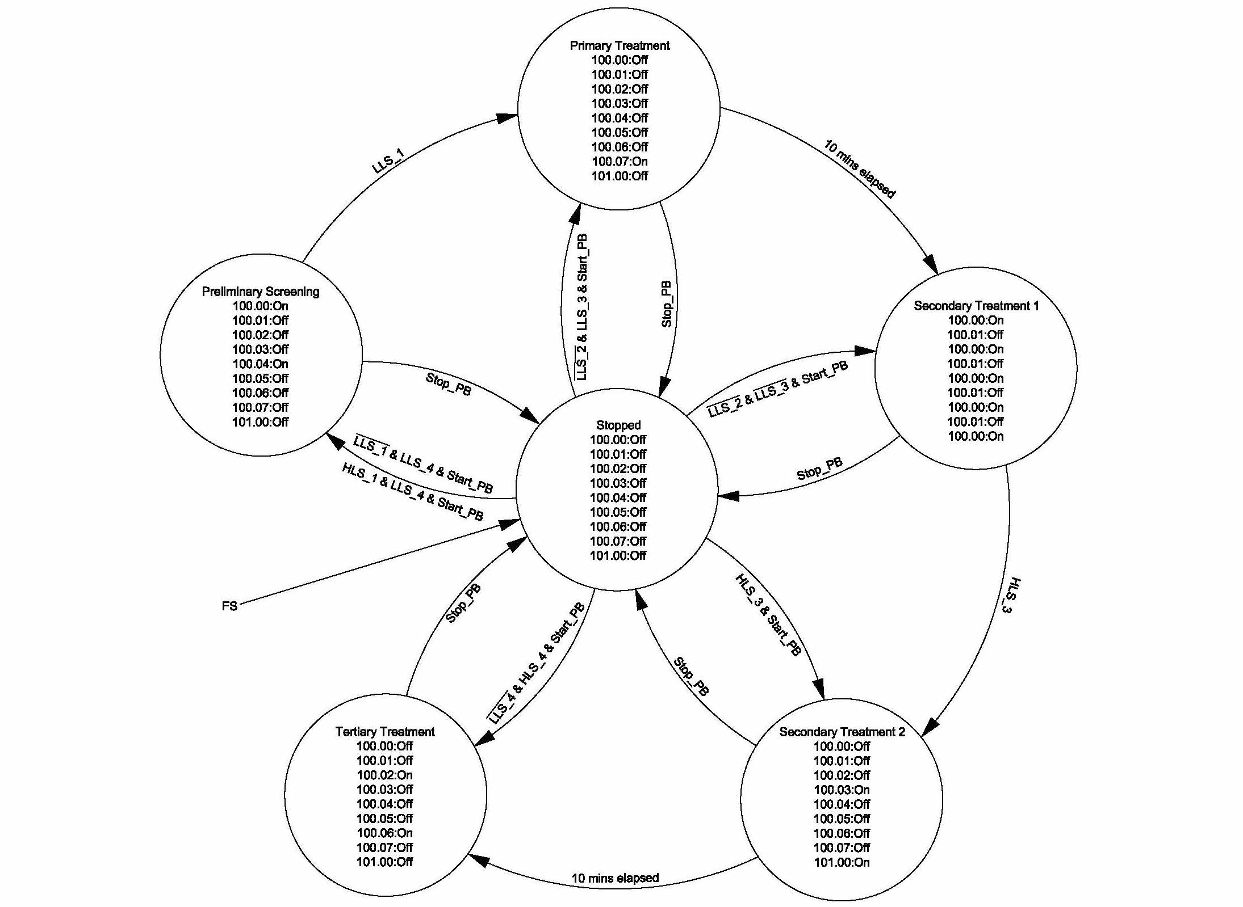
Sewage Treatment State Diagram

Slide 24
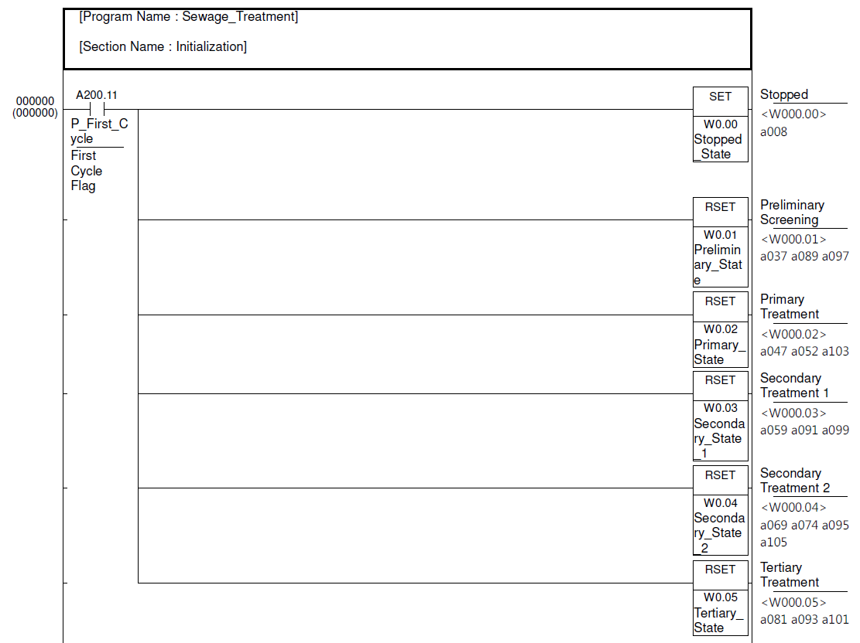
Ladder Logic: Initialization

Slide 25
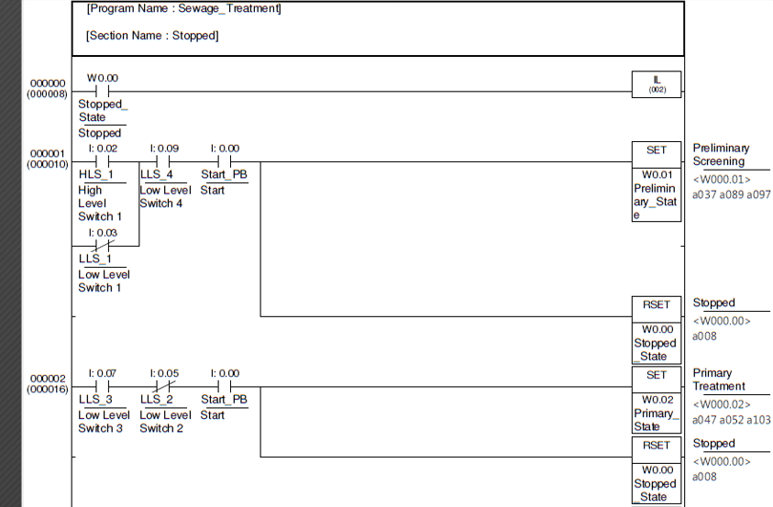
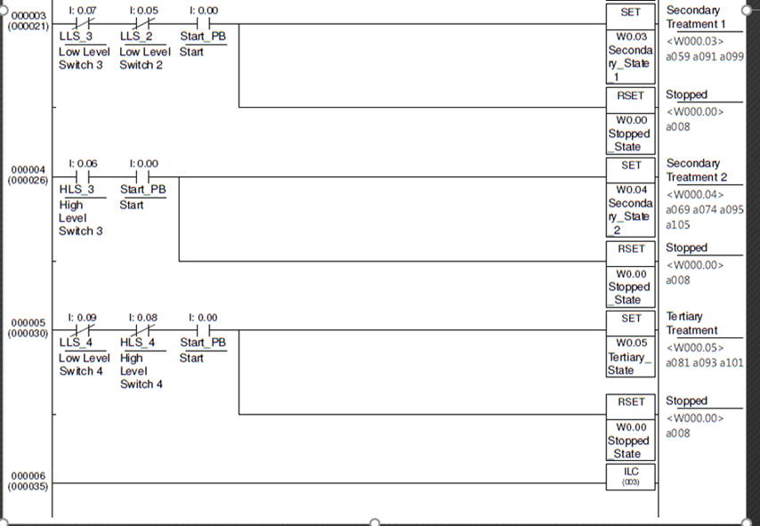
Ladder Logic: Stop

Slide 26
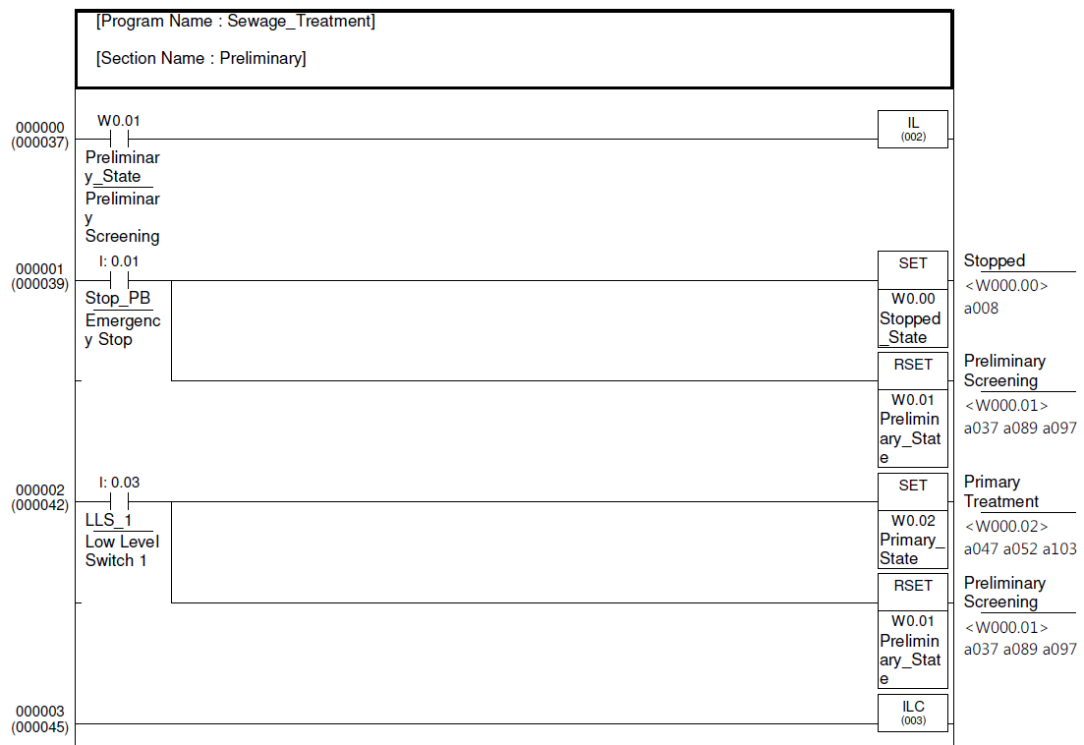
Ladder Logic: Preliminary

Slide 27
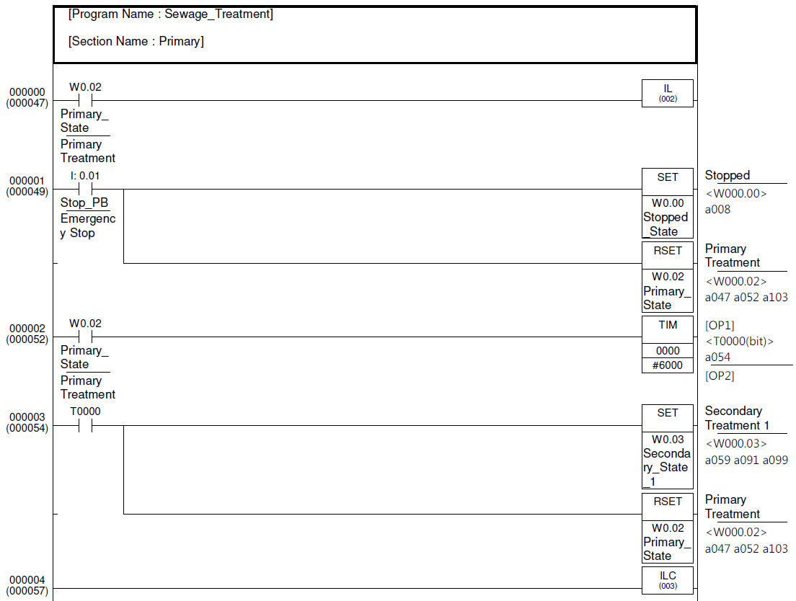
Ladder Logic: Primary

Slide 28
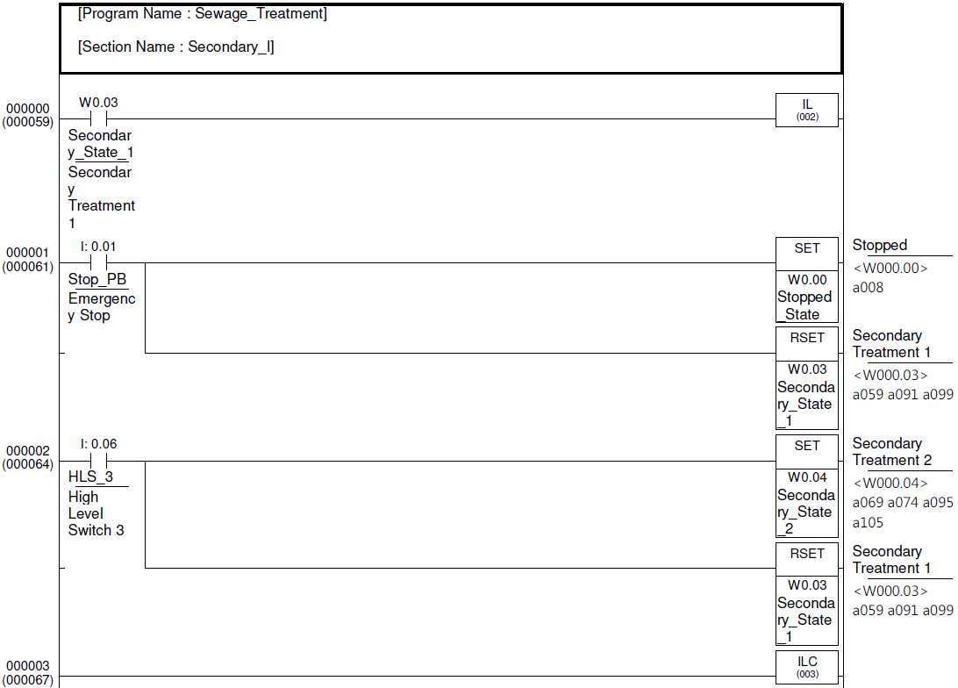
Ladder Logic: Secondary 1

Slide 29
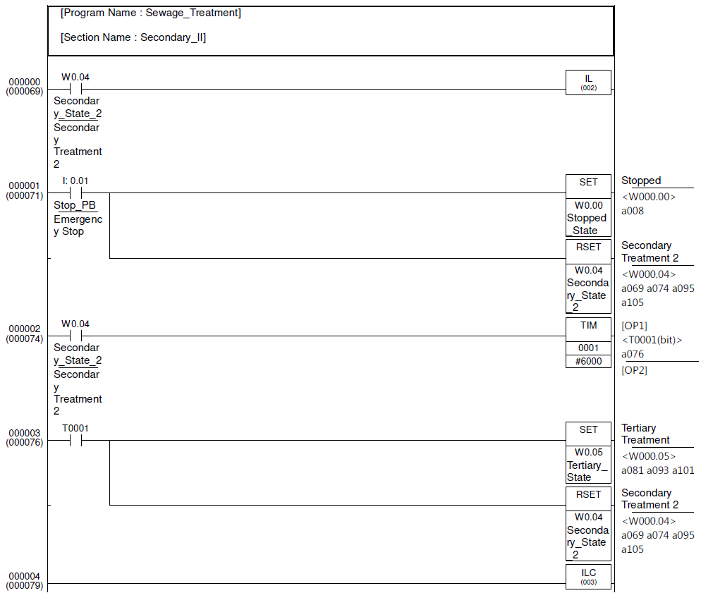
Ladder Logic: Secondary 2

Slide 30
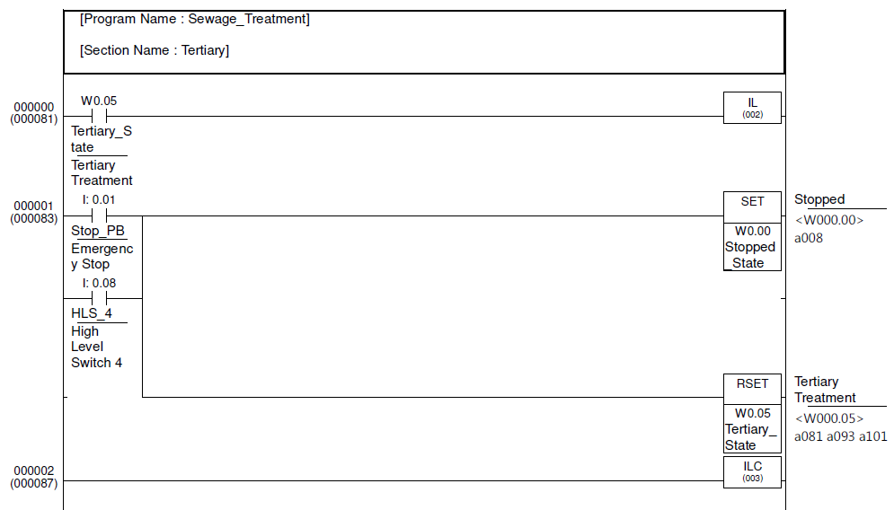
Ladder Logic: Tertiary

Slide 31
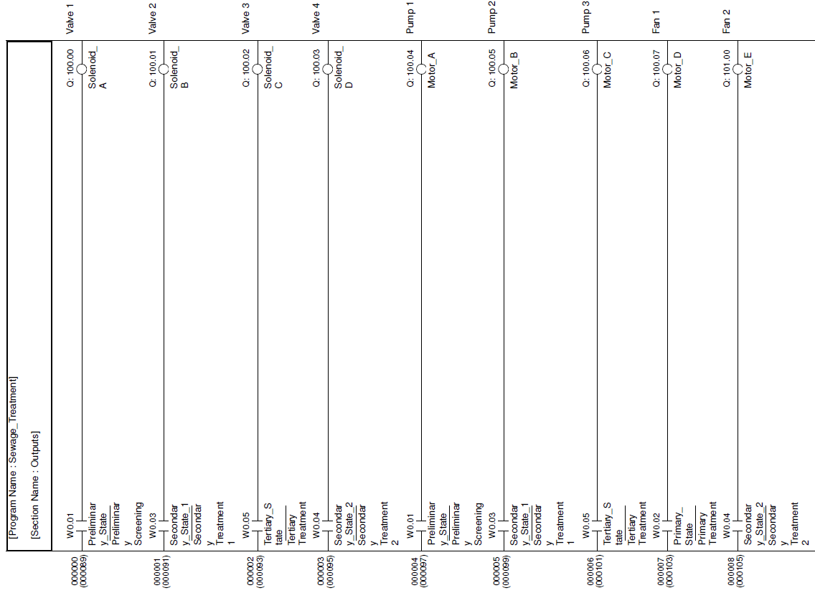
Ladder Logic: Outputs

Slide 32
Conclusions
Different Wastewater treatment plants use different processes to achieve different results.
Each plant requires customized automation and control.

Slide 33
Recommendations/Comments
Redundancy: Parallel streams and parallel components
Consider future expansion/modifications by designing the automation and control system using a modular approach.

Slide 34
References
https://www.automationdirect.com/adc/home/home
https://www.youtube.com/watch?v=W4uX2ZNQTfs
https://www.automationdirect.com/adc/shopping/catalog/water_(potable)_components/potable_water_solenoid_valves/stainless_steel_solenoid_valves/ns301yf02c3be7
https://www.asco.com/en-us/product/300/27012
https://www.automationdirect.com/adc/shopping/catalog/pneumatic_components/manual_air_valves/pneumatic_pushbutton_valves_and_operators/ecp3102

Slide 35
QUESTIONS?

Slide 36
THANK YOU

